Slide 1

BRİGHT STAR RETAİL
Tolga KARA
Dg168286

Slide 2
Introduction to Microsoft power bi
Microsoft created Power BI, a set of business analytics tools that let users see and talk about what they've learned from their company's data. It includes a number of tools and features that make it easier to turn data from different sources into business intelligence reports and live screens.
Power BI has several parts, such as Power BI Desktop, a desktop app for modeling data and making reports; Power BI Service, a cloud-based service for sharing, working together on, and publishing dashboards and reports; and Power BI Mobile Apps, which let users access and interact with their data while they're on the go.
The platform has an easy-to-use interface and works with many different types of data sources. This lets users connect, change, and see data to get useful insights. Additionally, Power BI lets you make live maps, generate reports, and use insights generated by AI.

Slide 3
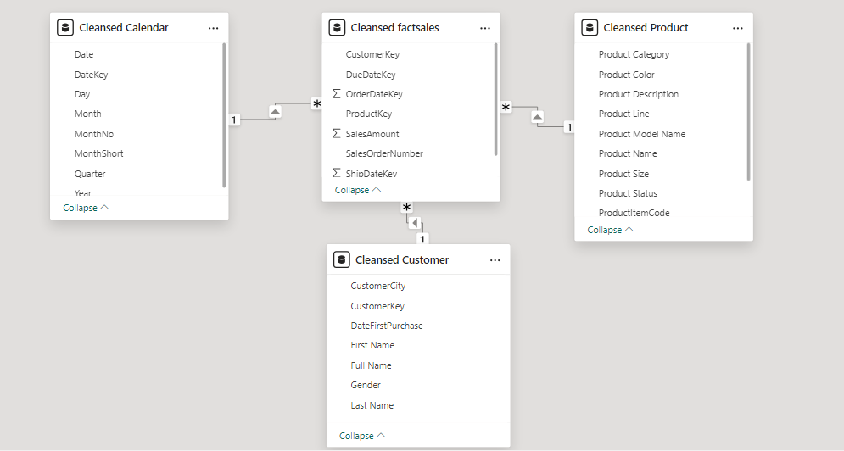
Cvs. Excel files

Slide 4
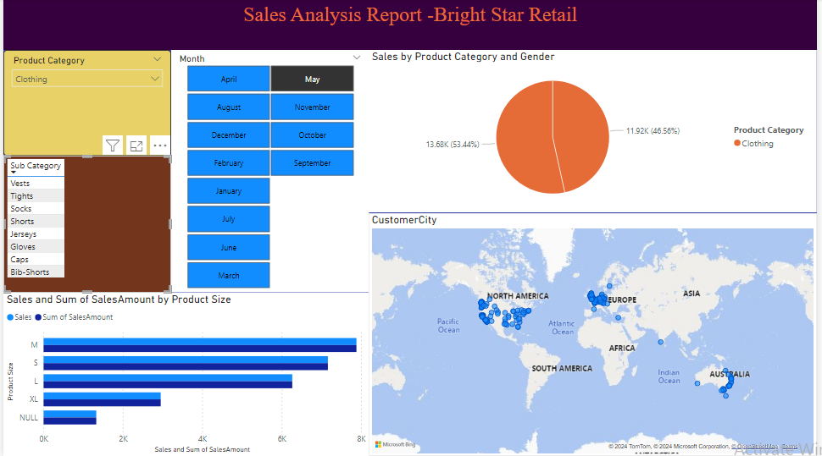
The information we see in the picture on this slide is about the vests that our customers bought in May
As you can see in the picture, our male customers are ahead in vest sales in May.
Mostly size M vests were sold, and size S and size L and size XL vests were sold, respectively.
On the customer city map, we see in which parts of the world sales are concentrated.

Slide 5
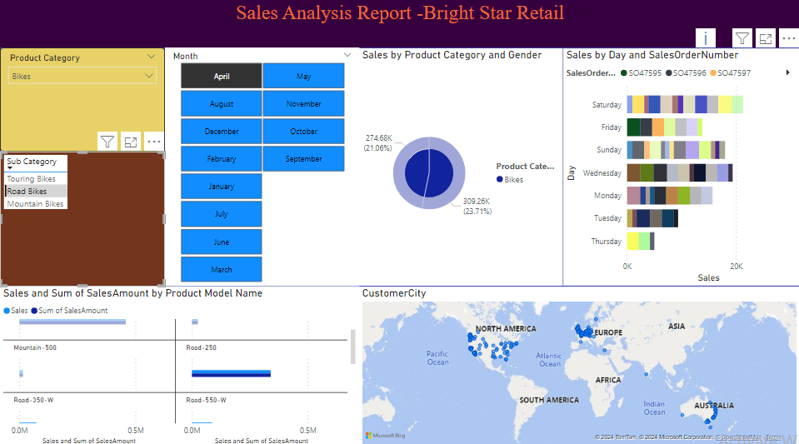
On this slide, we have data on bike sales in April
We see the total amount of sales according to the road bike product model name in the section on the left..
As can be seen in the upper corner on the right, we see sales and sales order numbers by day,according to which we have determined that sales increase on Saturdays
We see that female customers excel in sales with a sales figure of 309.26K in April.
.

Slide 6
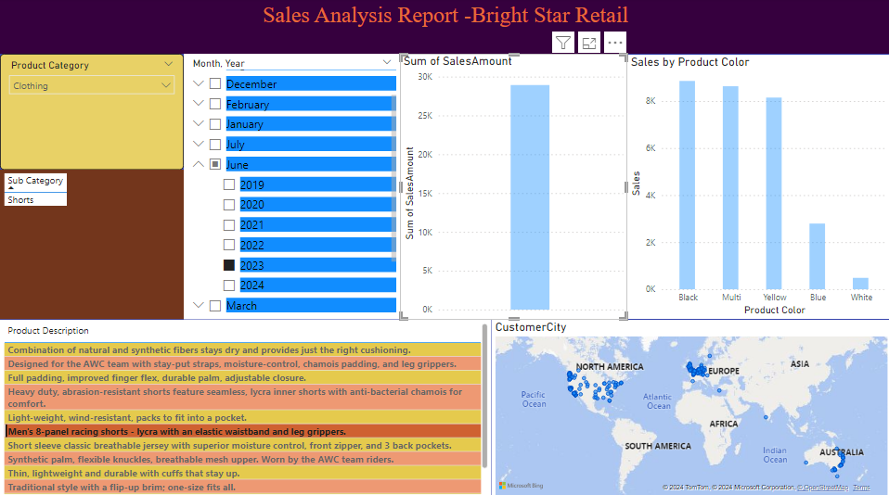
In the clothing category in June 2023, we examine the shorts sold by our company
In the section in the lower left corner there is a description of our shorts, next to it is in which cities they were bought.
In the upper right section, there is a total of the sales amount and it shows which color shorts are sold.
Compared to June 2023, black shorts are more preferred

Slide 7
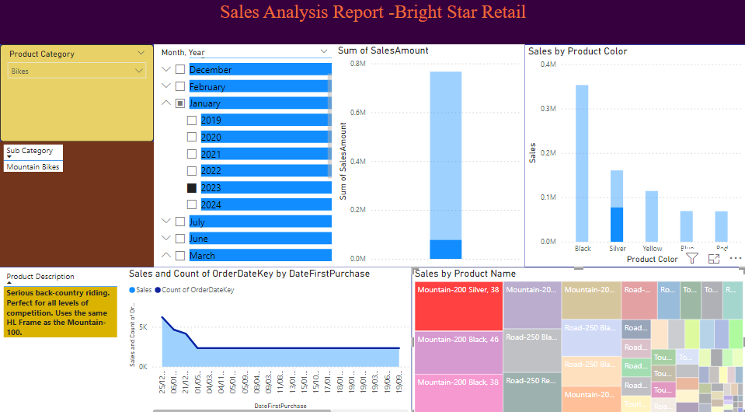
Let's examine the sales figures of the mountain bike 200, silver color 38
According to the figures for January 2023, the figures of the mountain bike 200 silver color 38 model are low compared to other models.
Product sales figures: 766,754 units sold Half the size of the black model.
In the lower section, you can see the description of the product, sales by the date of first purchase, the date of sale, the number of keys and the product names according to the sales on all bikes.

Slide 8
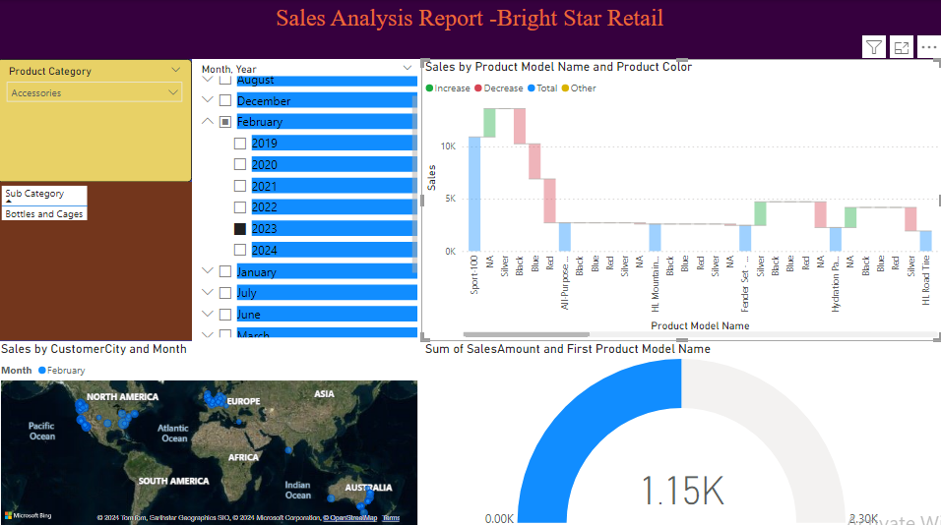
In this slide, we will examine water bottle sales for February 2023
On our map on the left, we can see which cities our customers shop from monthly.
In our scale chart at the bottom right, we can see the total sales amount and the first product model name
When we click on the water bottle in the waterfall chart at the top right, we can examine the product model name and product color chart.

Slide 9

THANK YOU

